Slide 1
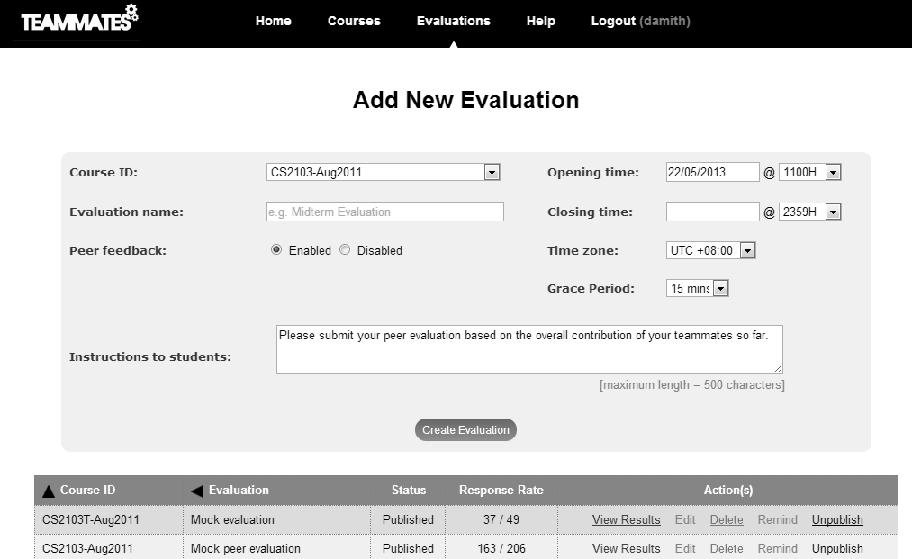
/Feedback Session
Session type
Standard team-project peer evaluation + peer feedback
?
Feedback session with my own questions
Record my own notes about students
* Copy of an existing session
Preview

Slide 2
New Evaluation/Feedback Session
course
Cs2103-jan2013
Time zone
GMT +8.0
Session name
Feedback for project demo
Session visible from
----
At the opening time
This is for my own eyes only
Open from
2013-May-01-12.00
to
2013-May-01-12.00
Grace period
10 minutes
Results visible from
----
I’ll make it visible later
I don’t plan to publish results
From the time the session becomes visible
Question 1
[TYPE: text [change]]
[x]delete question
What is the best selling point?
feedback from
(giver)
students
to
(receiver)
other teams
me
students
instructors
teams
none
self
own team members
own team
other teams
students
instructors
compulsory to answer
allow receiver to respond
Send response to giver
Answer visible to
Show giver name
Show receiver name
receiver(s)
Giver’s team members
Receiver’s team members
Other course mates
Instructors
[+]add question
Preview
Save
Notes:
Possible feature: a button to move question up/down
Possible feature: Copy question
Might need another section to specify the period for responding to feedback.

Slide 3
Feedback Session Results
course
Cs2103-jan2013
[more details]
Session name
Feedback for project demo
Open from
2013-May-01-12.00
to
2013-May-01-12.00
Results visible from
----
I’ll make it visible later
I don’t plan to publish results
Paragraph format - sort by giver
Paragraph format - sort by receiver
Table format - one answer column
Table format - multiple answer columns
Download
Upload more data
To: Team 1
[edit]
From: Betsy Ruth
Question 1 [What is the best selling poi...]
sample answer. sample answer. sample answer. sample answer. sample answer. sample answer. sample answer. sample answer. sample answer. sample answer. sample answer. sample answer. sample answer.
Question 2 [What is the biggest weakness...]
sample answer.
Question 3 [What is the overall rating...]
5/10.
From: Claire Wong
Question 1 [What is the best selling poi...]
sample answer. sample answer. sample answer. sample answer. sample answer. sample answer. sample answer. sample answer. sample answer. sample answer. sample answer. sample answer. sample answer.
Question 2 [What is the biggest weakness...]
sample answer.
Question 3 [What is the overall rating...]
5/10.

Slide 4
To: Instructor1
From: Betsy Ruth
Question 1 [What is the best selling poi...]
sample answer. sample answer. sample answer. sample answer. sample answer. sample answer. sample answer. sample answer. sample answer. sample answer. sample answer. sample answer. sample answer.
Question 2 [What is the biggest weakness...]
sample answer.
Question 3 [What is the overall rating...]
5/10.
From: Claire Wong
Question 1 [What is the best selling poi...]
sample answer. sample answer. sample answer. sample answer. sample answer. sample answer. sample answer. sample answer. sample answer. sample answer. sample answer. sample answer. sample answer.
Question 2 [What is the biggest weakness...]
sample answer.
Question 3 [What is the overall rating...]
5/10.
General questions
Question 1 [What is the best selling poi...]
[adam ] sample answer. sample answer. sample answer. sample answer.
[james] sample answer. sample answer. sample answer. sample answer. sample answer. sample answer. sample answer. sample answer. sample answer.
Question 2 [What is the biggest weakness...]
Answer 1: sample answer.
Answer 2: …

Slide 5
Feedback Session Results
Paragraph format - sort by giver
Paragraph format - sort by receiver
Table format - one answer column
Table format - multiple answer columns
Question 1 [What is the best selling poi...]
From: team | From: person | To: Team | To: Person | Answer
Team 1 | Alice Betsy | Team 2 | Ben Dean | 5
Team 1 | Alice Betsy | Team 2 | Charlie Davis | 5
Team 1 | - | Team 2 | - | 4
 | Alice Betsy |  | Fred Greene | 6
 | Ben Dean
 | Ben Dean
Instructors | Damith | Team 1 | - | Well done
Question 2 [What is the weakest ...]
Notes:
Table format - multiple answer columns: If multiple questions have the same from/to combination, we can show them as multiple columns in the same table rather than multiple tables

Slide 6
Feedback Session Results
course
Cs2103-jan2013
Session name
Feedback for project demo
Open from
2013-May-01-12.00
to
2013-May-01-12.00
Question 1 [What is the best selling poi...]
From: Betsy Ruth
sample answer. sample answer. sample answer. sample answer. sample answer. sample answer. sample answer. sample answer. sample answer. sample answer. sample answer. sample answer. sample answer.
From: Claire Wong
sample answer. sample answer. sample answer. sample answer. sample answer. sample answer. sample answer. sample answer. sample answer. sample answer. sample answer. sample answer. sample answer.
Question 2 [What is the biggest weakness...]
Answer 1:
sample answer. sample answer. sample answer. sample answer. sample answer.
Answer 2:
sample answer. sample answer. sample answer. sample answer. sample answer. sample answer. sample answer. sample answer. sample answer. sample answer. sample answer. sample answer. sample answer.

Slide 7
Submit Feedback
course
Cs2103-jan2013
Session name
Feedback for project demo
Open from
2013-May-01-12.00
to
2013-May-01-12.00
feedback from
students
to
other teams
Question 1
What is the best selling point?
Answer visible only to:
The receiving team/student can see the answer and your name.
Instructors can see the answer, the name of the receiving student/team, and your name.
Other students in the course can see the answer but not your name or the receiver name.
To: team 1
To: team 2
To: team 3
Question 2
What is the weakest point?
Answer visible to
Your name visible to
Receiver name visible to
receiver
teammates
Other course mates
course instructors
To: team 1
What is the best selling point?
To: team 2
What is the best selling point?
To: team 3
What is the best selling point?

Slide 8
Comment
Comment
I think this response is unfair
Comment about
Course
Session
Question
Answer
Team 1
to
(receiver)
Giver
Receiver
Team
Student
Adam Beng
Comment visible to
Show your name
Show receiver name
receiver(s)
giver’s team members
Other course mates
Instructors
Save
Delete

